Slide 1
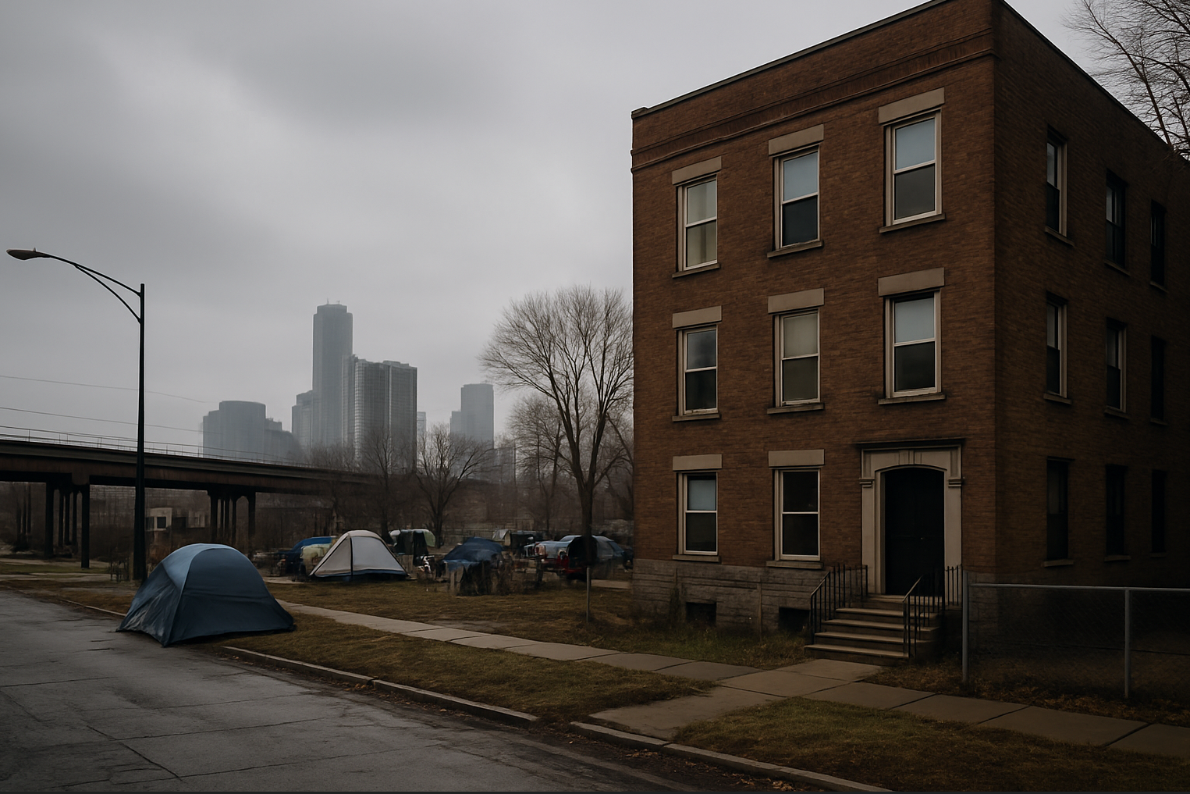
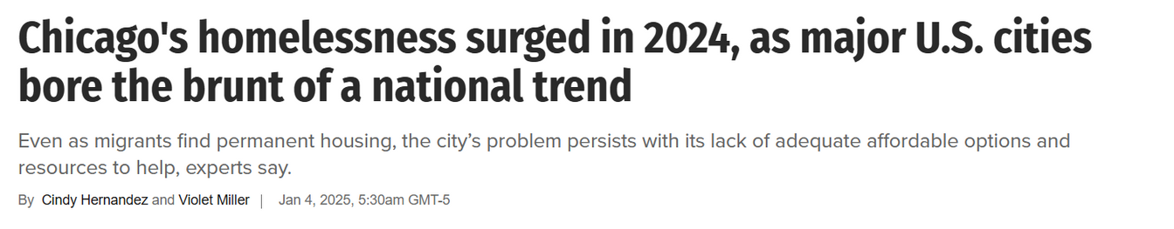
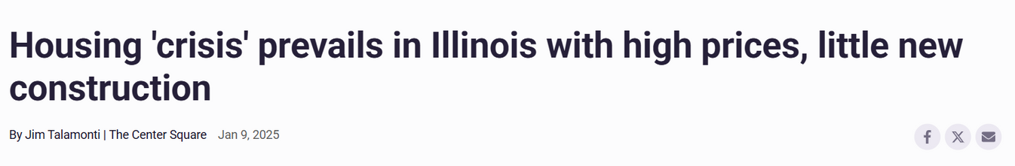
Reclaim, Reform, Rehouse
The 3R’s for Affordable Housing
A response to Chicago’s 126,000-unit shortfall, rising homelessness, and vacancy-driven disinvestment
1

Slide 2
The Road to 126,000+ Affordable Units
ChiHousingHub
Unified Housing Initiative
A Centralized Marketplace for Reactivating
Vacant Housing
A Zoning & Development Reform Package for Inclusive Growth
+20,000 Affordable Units
Transit-Oriented
Upzoning Framework
Building Homes on
Vacant Land
Allows 2–6 unit buildings near transit + affordability incentives
Infill development in underbuilt areas, tied to form-based codes
+117,000 Affordable Units
+35,000 Affordable Units

Slide 3
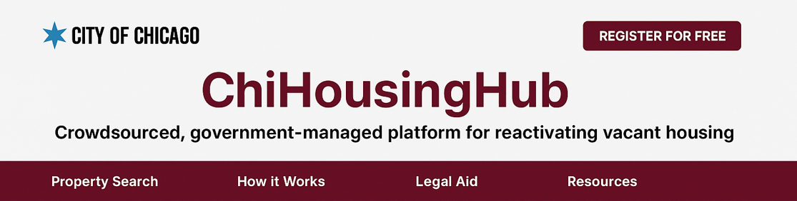
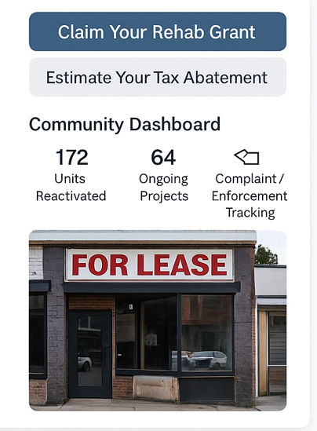
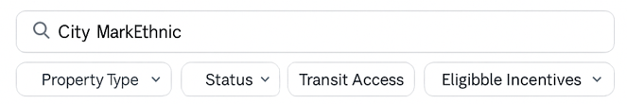
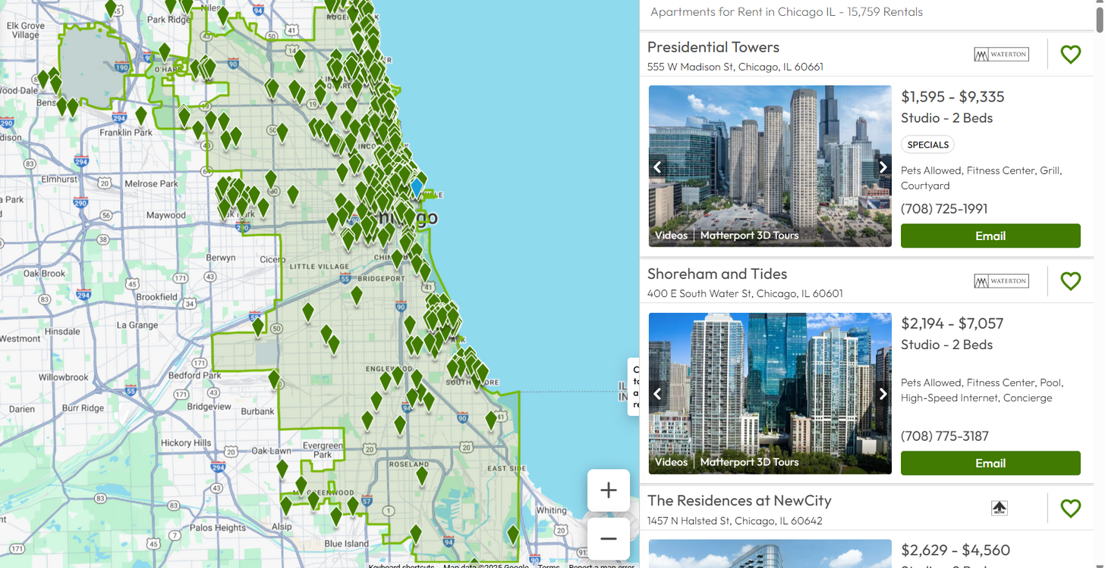
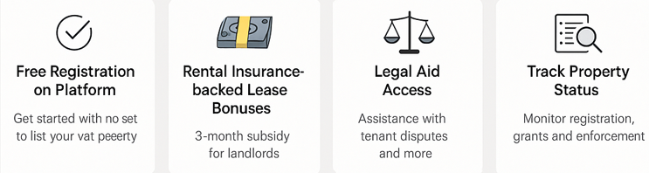
ChiHousing Hub: Crowd Sourced, Government Managed Platform for Reactivating Unoccupied Units
Key Features
Search
Eligible Incentives
50% TMOD
20,000+ projected new affordable units over 20 years

Slide 4
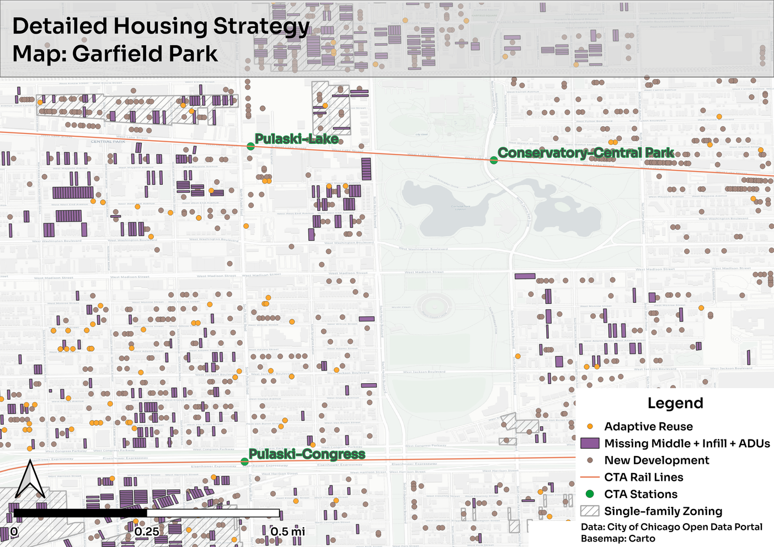
Unified Housing Initiative: Using Vacant Land
Unified Housing Initiative
Using Vacant Land
3 Types of Undeveloped Land
1. City-owned land
Transfer to non-profit builders and community trusts.
Pulaski Lake
Conservatory Central Park
2. Private underused parcels
Incentivized construction through tax relief for affordable units, striking a smart balance.
3. Vacant buildings
Fast-tracked for adaptive reuse and rehab grants.
Pulaski Congress
35,000+ projected new affordable units over 20 years
4

Slide 5
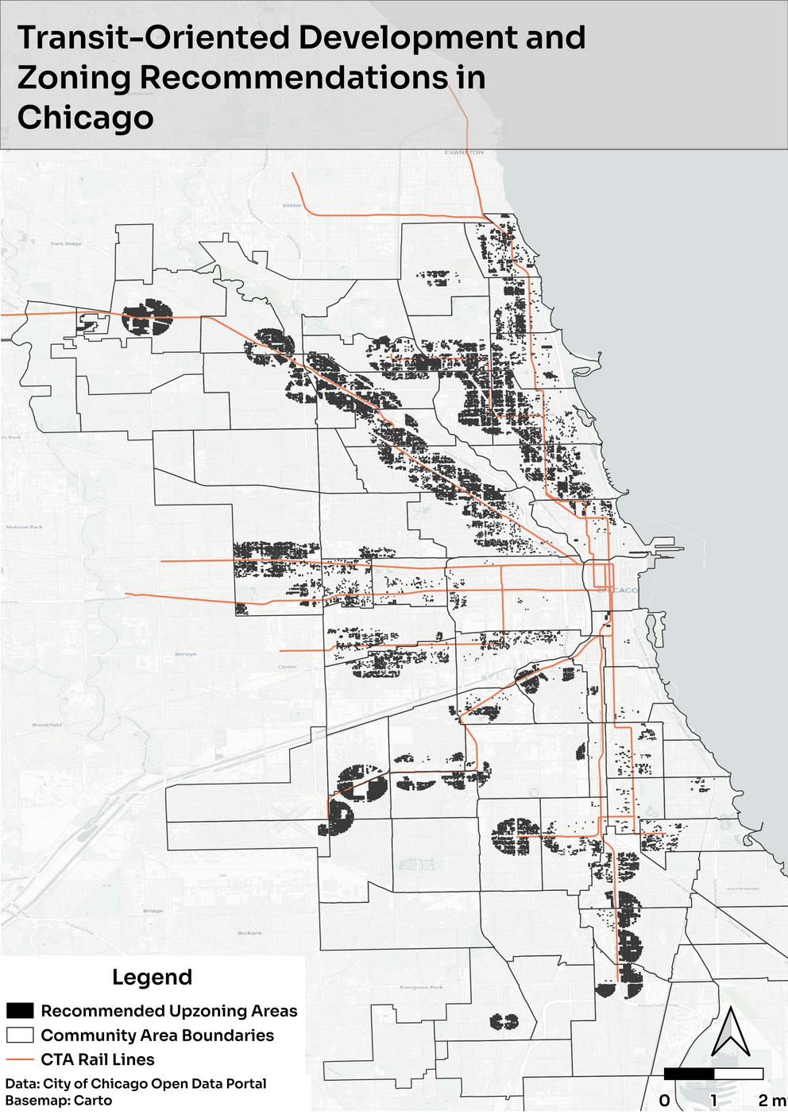
Unified Housing Initiative: Smart Upzoning
Phase 1: Pilot Program Near Transit
Upzone 41,000 single-family parcels near urban assets
Density bonuses and reduced parking minimums for affordability
Phase 2: Neighborhood opt-in
Neighborhoods and wards can voluntarily adopt zoning overlays
Phase 3: Citywide Expansion
Consider adopting triplex zoning citywide as a baseline
Transit-Oriented Development: 37,000+ affordable new homes
Citywide Expansion: 80,000+
5

Slide 6
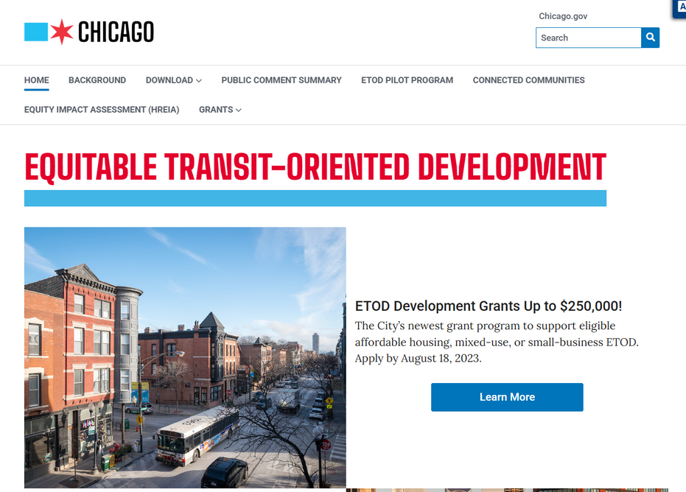
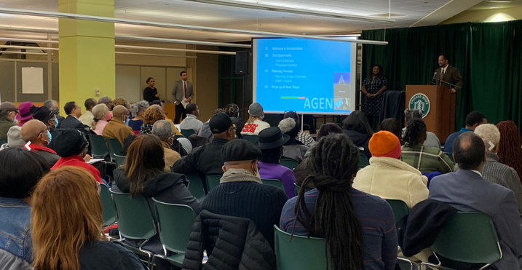
Equitable, Mixed-Income Housing Near Transit
Pricing Model
20%
50%
30%
- Balances long-term
affordability & profitability
- Builds economically diverse neighborhoods
6

Slide 7
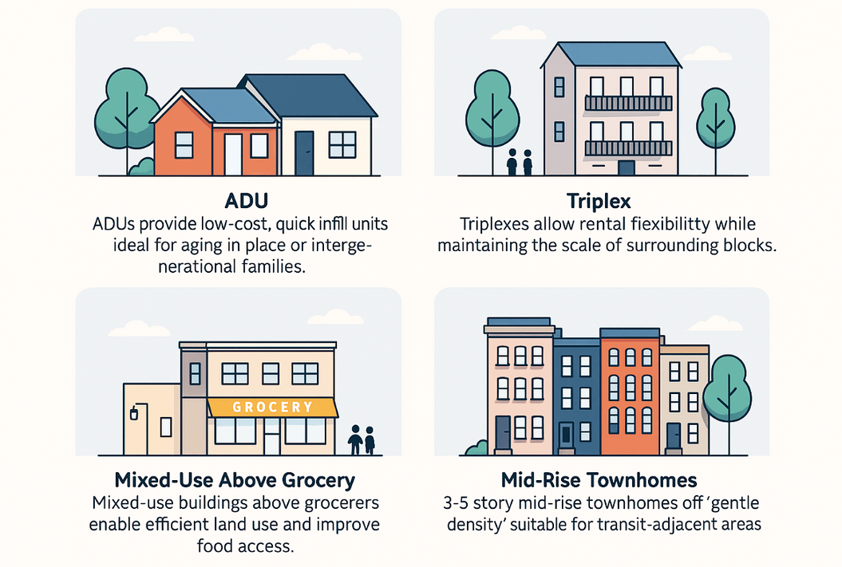
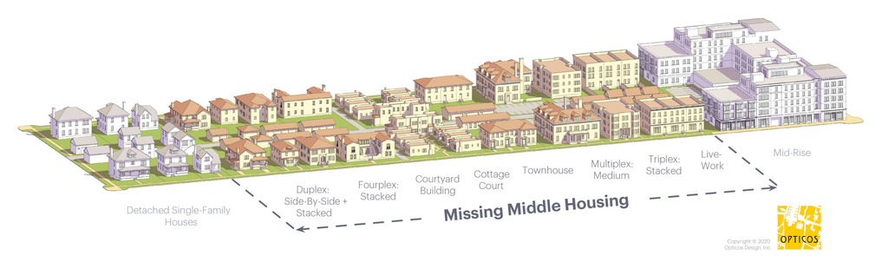
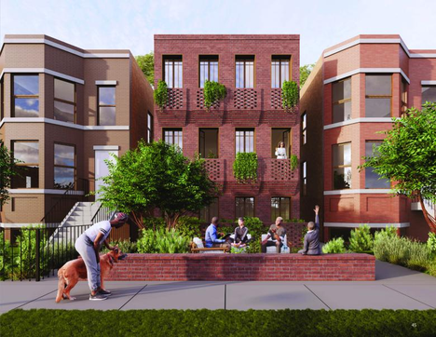
Ensuring Neighborhood Fit
Ensuring Neighborhood Fit
Building the “Missing Middle”
Housing that fits every lifestyle
Diverse, attractive, human-scale development.
Form-based Design Principles
Friendly street fonts, visible green space, welcoming entrances, and neighborhood architecture.
Implementation Strategies
Community design workshops, Community Benefits Agreements, pre-approved architectural plans, and more
7

Slide 8
Turning Risks into Levers
Turning Risks into Levers
Challenge
Implication
Response
Result
Funding Volatility
Cash‐flow gaps could stall development
KPI‐Gated Disbursements
Diversified Capital Stack
Political & Community Pushback
Zoning reforms & fees may face local resistance
Gradual Opt-ins & Community Design Workshops
Coalition Building
Interagency Fragmentation
Siloed approvals delay timelines
Governance Charter
Transparent Communication & Real-Time Dashboard
Small‐Owner Capacity Gaps
Owners struggle with new portal & compliance
“Concierge” Tech Assistance
Removed Barriers & Friction
8

Slide 9
Implementation and Financial Model
Phase 1 - $30 Million
2025-26
Phase 2 - $60 Million
2027-30
Phase 3 – $100+ Million
2031-35
Initiatives & Milestone
Initiatives & Milestone
Initiatives & Milestone
Pilot Launch
Regulatory Setup
Community Engagement
Platform scaling - Up to 5,000+
Redevelopment
Zoning reforms
Institutional Partnerships
City wide institutionalization
Sustainable CLT Expansion
Long term reinvestment
Funding Mix & Sources
Funding Mix & Sources
Funding Mix & Sources
Public (30%)
Private (50%)
Philanthropy (20%)
Public (25%)
Private (60%)
Philanthropy (15%)
Public (20%)
Private (70%)
Philanthropy (10%)
Stakeholder & Benefits
Stakeholder & Benefits
Stakeholder & Benefits
City Govt. – Policy Innovation, Housing Utilization
Property Owners – Rental Income
Private Investors – Scale rental markets
Municipal Planning Departments – Effective data planning, revitalization
Govt. Agencies – Streamlined policies
Real Estate Developers – Diversified source funds
9

Slide 10
Tying It All Together
ChiHousing Hub
(Vacancy Activation)
Unified Housing Initiative
(Reform + Rehouse)
One-stop portal for vacancy registration, fast-track permits, grants, low-cost loans
Live dashboard tracks progress
Cuts approval cycles by 50% and maximizes rehab pipeline visibility
Graduated-density zoning overlays
Framework for infill on currently vacant land
Guarantees deep-affordability to 37,000+ units citywide
Integrated Platform
“Reclaim → Reform → Rehouse”
Precision Rollout with Embedded KPIs
Aligned Incentives & Financial Backbone
GIS-targeted 41,500+ parcels near transit
3-phase launch (Pilot → Scale → Citywide)
Phased KPIs de-risk funding and deliver measurable wins
Density bonuses, reduced parking, pre-approved plans
Grants for smart development
Balances profit motives with long-term stewardship
Milestone-Driven Expansion with Reward-Driven Financing
We’re rewriting Chicago’s housing playbook with data, smart incentives & community at the core
9

